Slide 1
CSCI262 – System Security
Client Puzzle
Sionggo Japit
sjapit@uow.edu.au
20 October 2021

Slide 2
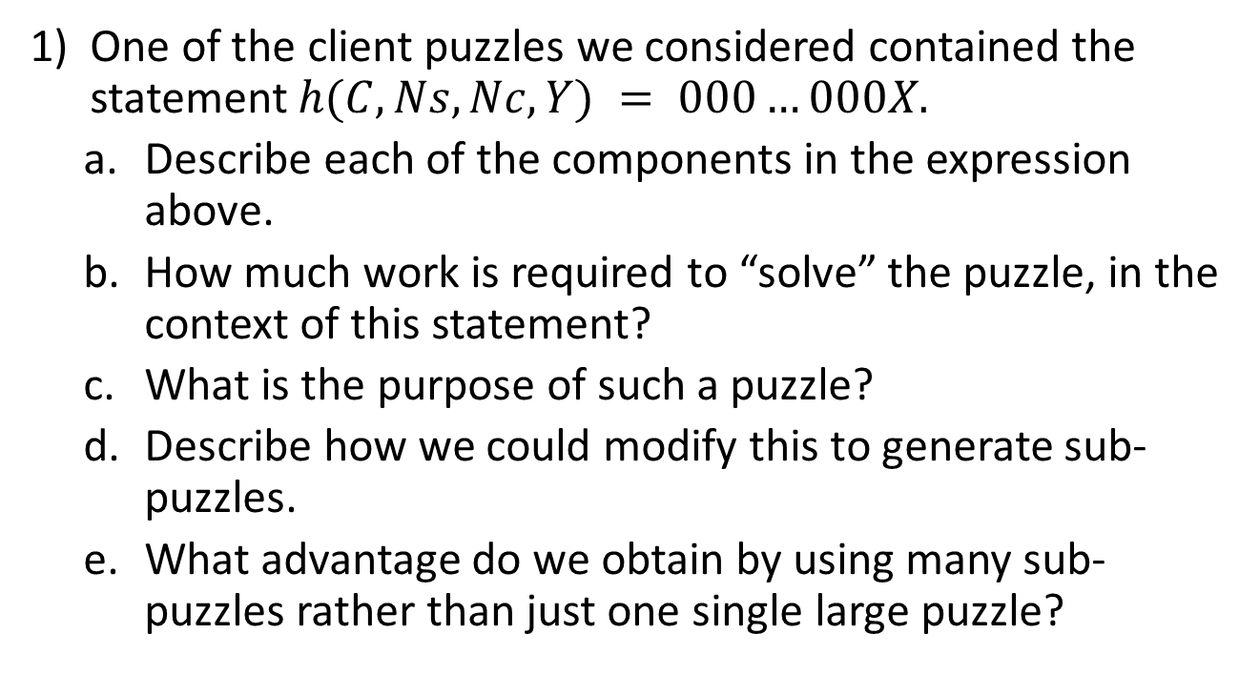
Question 1 …1
One of the client puzzles we considered contained the statement $h(C, Ns, Nc, Y) = 000…000X.$
Describe each of the components in the expression above.
How much work is required to “solve” the puzzle, in the context of this statement?
What is the purpose of such a puzzle?
Describe how we could modify this to generate sub-puzzles.
What advantage do we obtain by using many sub-puzzles rather than just one single large puzzle?
SIM-2013-S3-CSCI262-S4b_p6, page 19

Slide 3
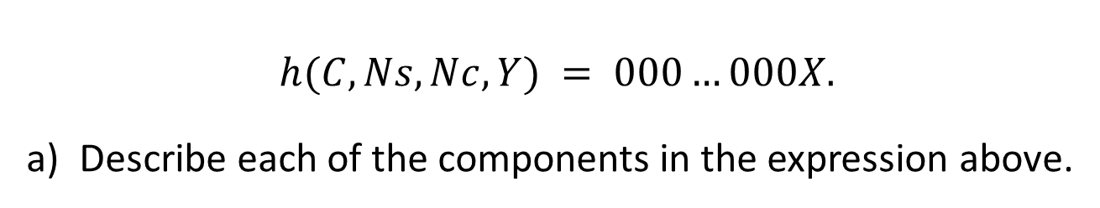
Question 1 …2
$$h(C, Ns, Nc, Y) = 000…000X.$$
Describe each of the components in the expression above.

Slide 4
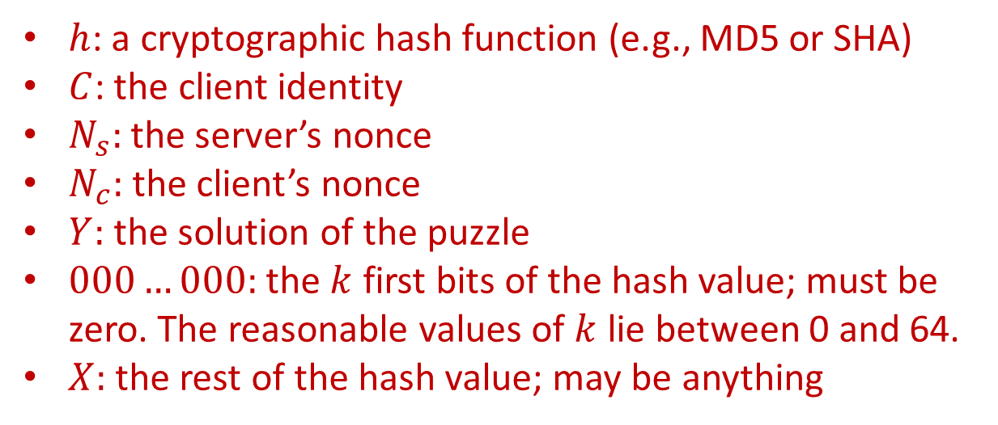
Question 1 …2
$$h(C, Ns, Nc, Y) = 000…000X.$$
Describe each of the components in the expression above.
$h$: a cryptographic hash function (e.g., MD5 or SHA)
$C$: the client identity
$N_{s}:$ the server’s nonce
$N_{c}:$ the client’s nonce
$Y:$ the solution of the puzzle
$000…000:$ the $k$ first bits of the hash value; must be zero. The reasonable values of $k$ lie between 0 and 64.
$X:$ the rest of the hash value; may be anything

Slide 5
Question 1 …3
How much work is required to “solve” the puzzle, in the context of this statement?
SIM-2013-S3-CSCI262-S4b_p6, page 19

Slide 6

Question 1 …3
How much work is required to “solve” the puzzle, in the context of this statement?
The cost of solving the puzzle depends exponentially on the required number of $k$ of zero bits in the beginning of the hash. If $k=0$, no work is required. If $k=64$, then in the worst case, it would be $2^{k}.$ In such a puzzle, the reasonable values of k lie between 0 and 64.
SIM-2013-S3-CSCI262-S4b_p6, page 19

Slide 7
Question 1 …4
What is the purpose of such a puzzle?
SIM-2013-S3-CSCI262-S4b_p6, page 19

Slide 8
Question 1 …4
What is the purpose of such a puzzle?
The purpose of such a puzzle is to ensure that the client should always commit its resources to the authentication protocol first and the server should be able to verify the client commitment before allocating its own resources.
SIM-2013-S3-CSCI262-S4b_p6, page 19

Slide 9
Question 1 …5
Describe how we could modify this to generate sub-puzzles.
Notes:
At the time when server does this setup, server does not save state or do expensive computations.

Slide 10
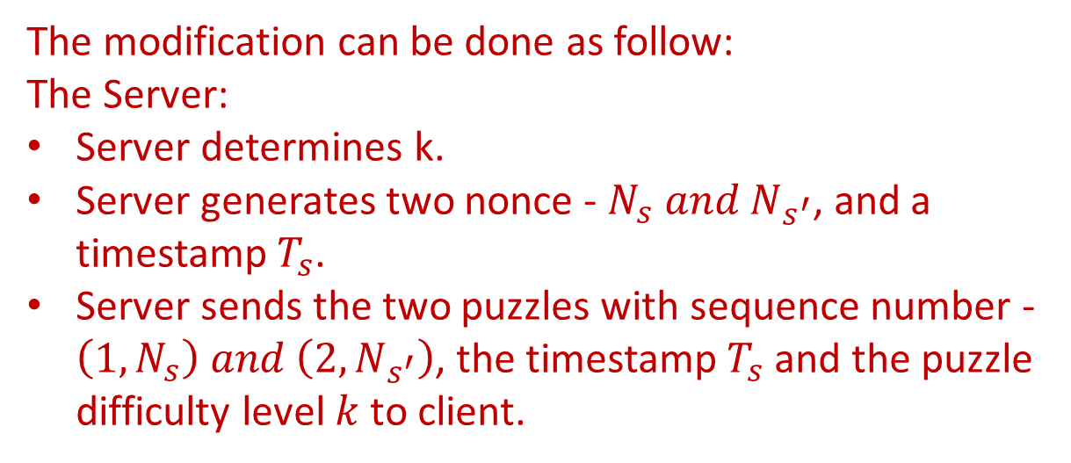

Question 1 …5
Describe how we could modify this to generate sub-puzzles.
The modification can be done as follow:
The Server:
Server determines k.
Server generates two nonce - $N_{s} and N_{s^{′}}$, and a timestamp $T_{s}$.
Server sends the two puzzles with sequence number - $\left(1, N_{s}\right) and \left(2, N_{s^{′}}\right)$, the timestamp $T_{s}$ and the puzzle difficulty level $k$ to client.
Client
$$\left(1, N_{s}\right), \left(2, N_{s^{′}}\right), T_{s}, k$$
Server
Notes:
At the time when server does this setup, server does not save state or do expensive computations.

Slide 11
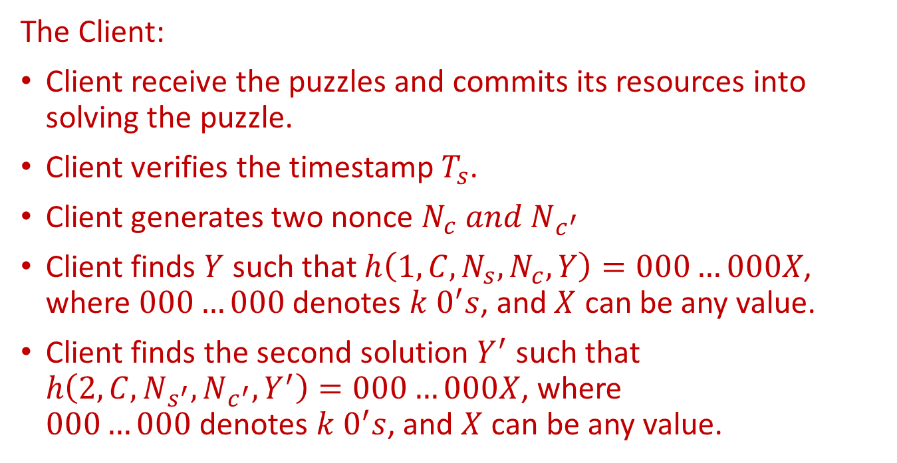
Question 1 …6
The Client:
Client receive the puzzles and commits its resources into solving the puzzle.
Client verifies the timestamp $T_{s}$.
Client generates two nonce $N_{c} and N_{c^{′}}$
Client finds $Y$ such that $h\left(1,C,N_{s},N_{c},Y\right)=000…000X$, where $000…000$ denotes $k 0^{′}s$, and $X$ can be any value.
Client finds the second solution $Y^{′}$ such that $h\left(2,C,N_{s^{′}},N_{c^{′}},Y^{′}\right)=000…000X$, where $000…000$denotes $k 0^{′}s$, and $X$ can be any value.
SIM-2013-S3-CSCI262-S4b_p6, page 19

Slide 12
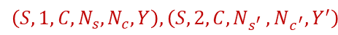
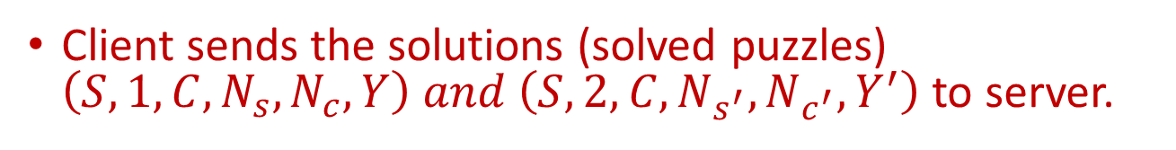
Question 1 …7
Client sends the solutions (solved puzzles) $\left(S,1,C,N_{s},N_{c},Y\right) and \left(S,2,C,N_{s^{′}},N_{c^{′}},Y^{′}\right)$ to server.
Client
$$\left(S,1, {C,N}_{s},N_{c},Y\right), \left(S,2, C,N_{s^{′} },N_{c^{′}}, Y^{′}\right)$$
Server
SIM-2013-S3-CSCI262-S4b_p6, page 19

Slide 13
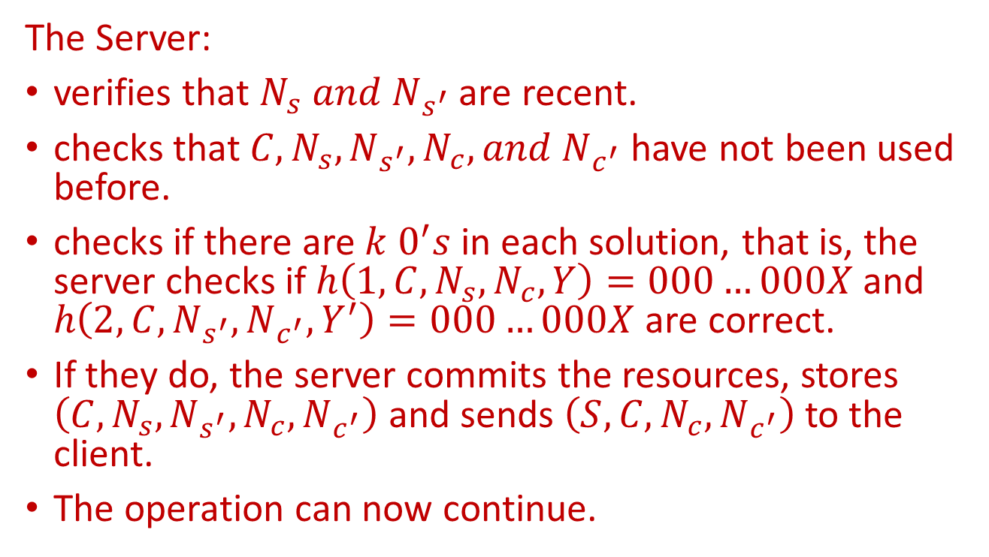
Question 1 …8
The Server:
verifies that $N_{s} and N_{s^{′}}$ are recent.
checks that $C,N_{s},N_{s^{′}},N_{c}, and N_{c^{′}}$ have not been used before.
checks if there are $k 0^{′}s$ in each solution, that is, the server checks if $h\left(1,C,N_{s},N_{c},Y\right)=000…000X$ and $h\left(2,C,N_{s^{′}},N_{c^{′}},Y^{′}\right)=000…000X$ are correct.
If they do, the server commits the resources, stores $\left(C,N_{s},N_{s^{′}},N_{c},N_{c^{′}}\right)$ and sends $\left(S,C,N_{c},N_{c^{′}}\right)$ to the client.
The operation can now continue.
SIM-2013-S3-CSCI262-S4b_p6, page 19

Slide 14
Question 1 …9
What advantage do we obtain by using many sub-puzzles rather than just one single large puzzle?
SIM-2013-S3-CSCI262-S4b_p6, page 19

Slide 15
Question 1 …9
What advantage do we obtain by using many sub-puzzles rather than just one single large puzzle?
If we use a single big puzzle instead of sub puzzles, then the difficulty level is hard to adjust. This is because one bit of change in k could require a much longer time to solve the puzzle. Using sub puzzles we can fine tune the difficulty level.
SIM-2013-S3-CSCI262-S4b_p6, page 19

Slide 16
Spring 2016 – Part B, Question 3

Slide 17
CSCI262-System Security
A company has three departments A, B and C, and has determined that it is appropriate to have two levels of sensitivity, in increasing order: L and H. Draw a BLP lattice system to represent this scenario.
CSCi262 – System Security - Spring Session 2016, Part B, Question 3

Slide 18
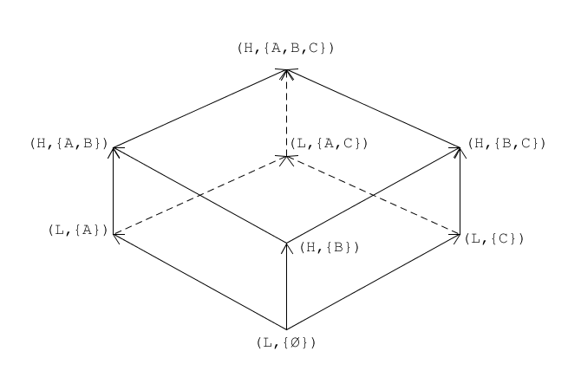
CSCI262-System Security
A company has three departments A, B and C, and has determined that it is appropriate to have two levels of sensitivity, in increasing order: L and H. Draw a BLP lattice system to represent this scenario.
CSCI262 – System Security - Spring Session 2016, Part B, Question 3

Slide 19
Spring 2016 – Part C, Question 2

Slide 20
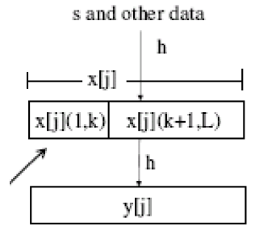
Spring 2016, Part C - Question 2
Consider the diagram to the right and answer the following questions:
What is the context of this diagram?
What is sent to the client and how is this generated?
What should the client respond with?
What is the role of k?
How much work would we expected the client to do?
Is the answer from the client unique? Justify your answer.

Slide 21
Part C – Question 2 …2
What is the context of this diagram?

Slide 22
Part C – Question 2 …2
What is the context of this diagram?
The diagram refers to the construction of client puzzles.

Slide 23
Part C – Question 2 …3
What is sent to the client and how is this generated?

Slide 24
Part C – Question 2 …3
What is sent to the client and how is this generated?
X[j](k+1,L) is sent to the client. This is generated by taking a sub-puzzle and taking k bit as the solution of the puzzle

Slide 25
Part C – Question 2 …4
What should the client respond with?

Slide 26
Part C – Question 2 …4
What should the client respond with?
The client should respond with x[j](1,k) to be joined with x[j](k+1,L) to get y[j].

Slide 27
Part C – Question 2 …5
What is the role of k?

Slide 28
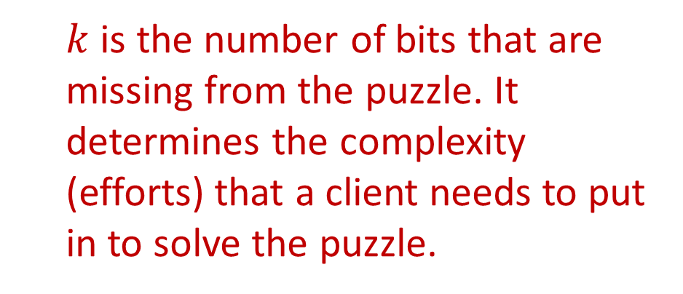
Part C – Question 2 …5
What is the role of k?
$k$ is the number of bits that are missing from the puzzle. It determines the complexity (efforts) that a client needs to put in to solve the puzzle.

Slide 29
Part C – Question 2 …6
How much work would we expected the client to do?

Slide 30
Part C – Question 2 …6
How much work would we expected the client to do?
The client is expected to do minimal work so that the authentication can be fast.

Slide 31
Part C – Question 2 …7
Is this process stateless? Explain your answer.

Slide 32
Part C – Question 2 …7
Is this process stateless? Explain your answer.
Yes, the puzzle stores no information. The solution itself contains all the information the server needs other than their own server secret.

